Slide 1
Challenge for the hackathon
What will the future office look like in 2020?
Better utilization, open offices, creative workspaces
Utilizing Big Data, IoT, Analytics in a smart building ecosystem
Energy efficient buildings
Energy usage, analytics
Combining energy information to building automation, how to steer the building?
Innovative dashboard for energy consumption follow up
Inspiring UI experience for building automation system
Data visualization
How to visualize alerts, conditions, utilization, maintenance etc
Gamification of maintenance tasks
Uberisation, market place for B2B or B2C maintenance services
IoT
Automation
Analytics
VR/AR

Slide 2
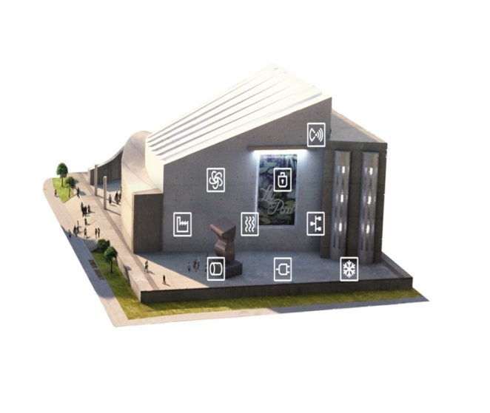
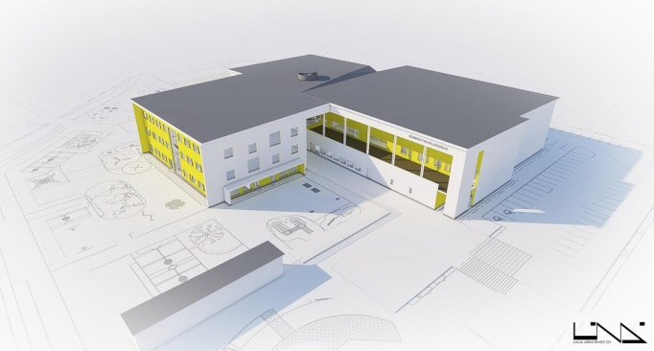
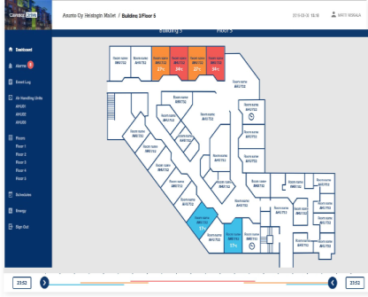
Caverion Datasets
Dataset A (Office building)
-BAS information through oBix interface
-Energy consumption data
-Maintenance system data (if available)
-Blueprints (if available)
-Externally available data (weather etc.)
Dataset B (School)
-BAS information through oBix interface
-Energy consumption data
-Maintenance system data
-Security system data (if available)
-Blueprints
-Externally available data (weather etc.)
Possible challenges:
-IoT applications
-Office utilization rate, predictions
-Energy consumption forecasts, optimization
-Equipment identification/data gathering in service process
Possible challenges:
-Machine/Deep learning in BAS IoT analytics, automatic parameter setting, predicting faults
-Teaching building users to operate building correctly, better utilization
-End user apps based on provided dataset

